Slide 1
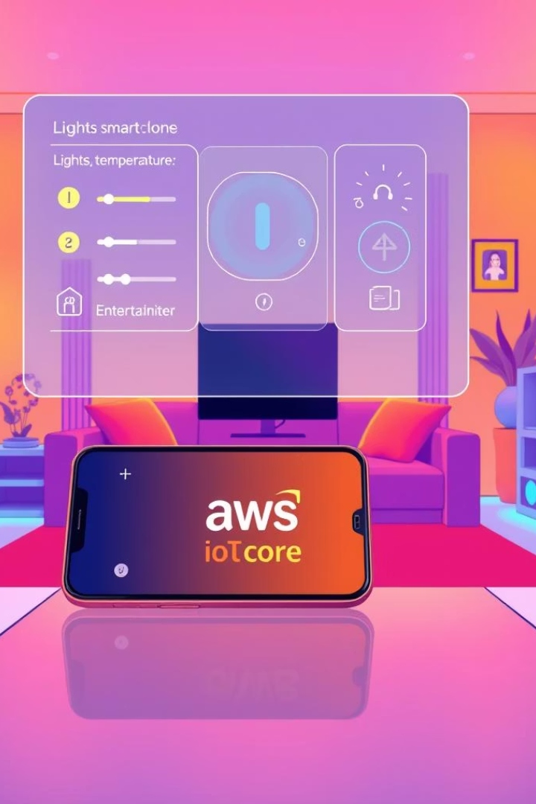
IoT-Based Smart Home Automation with AWS IoT Core
Revolutionize your home automation with remote control of devices. Use AWS IoT Core to simulate smart home functions. Achieve scalability and cost savings without physical hardware.

Slide 2

What is IoT and AWS IoT Core?
Internet of Things (IoT)
AWS IoT Core
Network of devices communicating data seamlessly.
Cloud service managing IoT device connections securely.
Protocols Supported
MQTT
HTTP
WebSockets

Slide 3
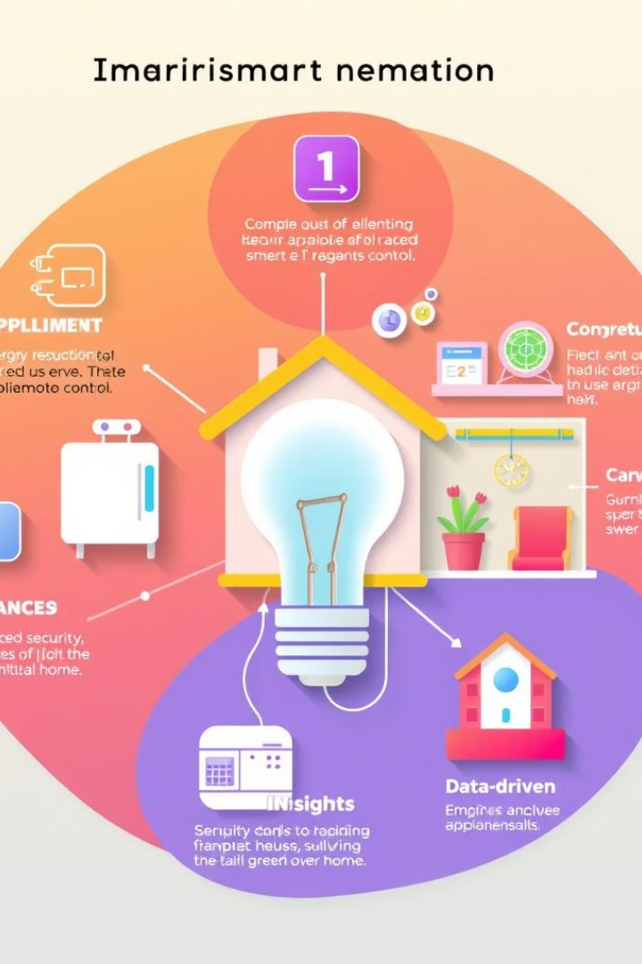
Benefits of IoT-Based Smart Home Automation
Remote Appliance Control
Manage your devices from anywhere in real-time.
Energy Efficiency
Save energy using smart scheduling and automation.
Enhanced Security
Virtual sensors monitor your home continuously.
Data-Driven Insights
Customize experiences based on usage patterns.

Slide 4
Architecture: Virtual Smart Home on AWS
AWS IoT Core
Virtual Devices
Supporting Services
Acts as central message broker for device communication.
Simulated sensors and actuators like lights & thermostats.
AWS Lambda for processing data
DynamoDB for device state storage
CloudWatch for monitoring
IAM for secure access

Slide 5
Step-by-Step Setup: Virtual Smart Home
Create AWS account and configure IAM roles.
Set up AWS IoT Core and define virtual device attributes.
Create IAM policies for secure access.
Develop Lambda functions to control virtual devices.
Route IoT messages to Lambda via IoT rules.
Build web interface using AWS Amplify for control.

Slide 6

Simulating Devices: Sending Data to AWS IoT Core
1
Use AWS IoT Device Simulator to mimic device behavior.
2
Generate realistic data: temperature, switch toggles.
3
Publish JSON messages to IoT Core topics.
4
Simulate thousands of devices concurrently for scale.

Slide 7








Scalability and Reliability
AWS IoT Core
AWS Lambda
Auto scales to millions of device connections seamlessly.
Serverless, pay-per-use compute for efficient processing.
CloudWatch
DynamoDB
Real-time monitoring and alerting for system health.
Highly available, distributed NoSQL database for states.

Slide 8

Security Best Practices
IAM Roles
Apply least privilege for tighter access control.
Device Authentication
Use certificates and keys to verify devices.
Data Encryption
Encrypted communication via TLS/SSL protocols.
AWS IoT Device Defender
Detect and mitigate security threats proactively.

Slide 9





Future Possibilities
Voice Assistant Integration
Machine Learning
Real Sensor Connectivity
Industry Expansion
Seamlessly control devices via Amazon Alexa.
Predictive maintenance powered by Amazon SageMaker.
Link real devices through Raspberry Pi gateways.
Smart agriculture, cities, and connected vehicles growth.

